Slide 1
Flow Fields
Programming – AI for Games
Last modified 09/02/16 by Sam Cartwright

Slide 2
Contents
Flow Field Pathfinding
Continuum Crowds
Examples:
March of the Froblins
Supreme Commander 2

Slide 3
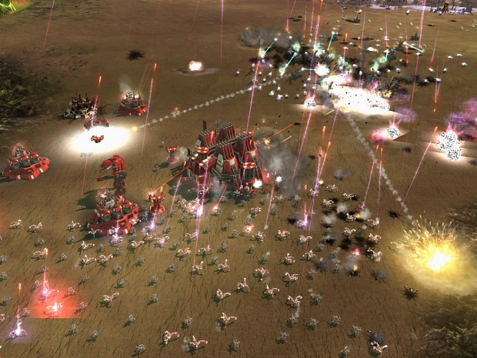
Pathfinding
Many algorithms work by calculating a path to the goal for each pathfinder
Adding twice as many agents doubles the time needed for pathfinding
Imagine an RTS with thousands of agents
Notes:
Many algorithms work by calculating a path to the goal for each pathfinder
Pathfinding is a problem with many solutions, and each will have its pros and cons.
In many games, pathfinding is calculated per agent. Meaning that each agent will calculate its own path to the goal, sometimes without regard to the paths of other agents.
This can cause a variety of problems, especially when two agents calculate an intersecting path and collisions occur.
Adding twice as many agents doubles the time needed for pathfinding
If we are calculating a path per pathfinding agent, this means that adding twice as many agents will double the time needed to perform pathfinding.
While this may be acceptable in may situations, when we are working with may thousands of pathfinders we require a more efficient approach
Imagine an RTS with thousands of agents
In many modern RTS games there can be thousands of agents in the game at any one time, and each one needs to intelligently pathfind from its current position to its destination. Obviously performing per-unit pathfinding calculations will be unreasonable in this situation.
So how do AI programmers handle these types of situations?

Slide 4
Using Flow Fields for Pathfinding
Allows us to calculate a path for all agents at once
Calculates a path from the goal to every node in the graph
This information is translated into a vector direction for each node (stored as a flow field)
Agents follow the directions in the flow field to navigate towards the goal
Notes:
One relatively simple technique we can use is called Flow Field pathfinding.
Put simply, we use a Flow Field containing a vector direction for each node on our graph (often a 2D grid). Then, each pathfinding agent simply has to follow the vector direction for the node it is currently on in order to traverse a path to the goal.
Allows us to calculate a path for all agents at once
By using this technique we calculate a direction for each node (if we’re using a 2D grid, then each tile) that will take us a along a path to the target. We do this once, then each pathfinding agent shares this data to update its position.
In fact, the individual agents have no knowledge about the world or their path other than the next direction they need to take.
Calculates a path from the goal to every node in the graph
Starting from the goal tile, we use a wavefront algorithm to radiate out from this note, calculating a cost for each tile that indicates the number of tiles it is away from the goal (think Dijkstra’s algorithm).
The difference between this technique and, say, something like Dijkstra’s is that we only stop once we’ve got a cost for every tile in our grid.
This information is translated into a vector direction for each node (stored as a flow field)
Using the costs for individual nodes, and the cost for their neighbouring nodes, we can calculate a vector for that node.
These vectors are what make up the Flow Field
Agents follow the directions in the flow field to navigate towards the goal
Once we have our flow field, all the agents need to do is move in the direction indicated in order to traverse a path to the goal.

Slide 5
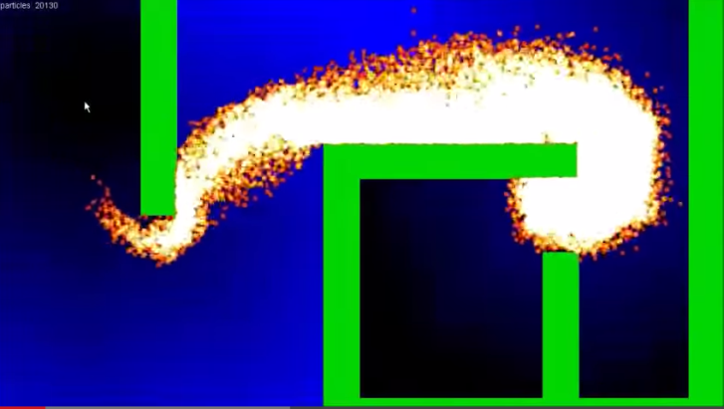
Why?
Allows hundreds/thousands of agents to path-find intelligently
Creates emergent behaviour
https://youtu.be/Bspb9g9nTto
Notes:
Why would we want to do pathfinding in this way?
For game genres like RTS, this will allow us to have hundreds or even thousands of agents intelligently pathfind within our game.
An added benefit is that this technique also creates emergent behaviour, so agents will appear to react to the environment in the same way as real people do when moving in a crowd.
When we calculate the cost for each node in our graph, we can modify this value with information like how many agents are currently on this node. This will increase the cost of the node making it undesirable for agents to move to.
The result of this is that agents will move around areas of high density. And the amazing thing is all this happens without the agent knowing anything about the environment or other agents. It is just following the direction vector for the node it is currently on!
The video link on this slide demonstrates the Flow Fields technique, which we will discuss in more detail in the following slides.

Slide 6
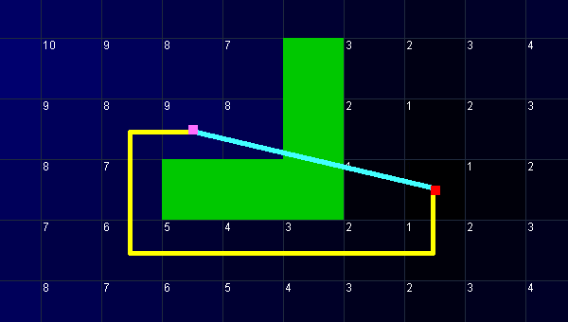
Step 1: Calculate Distance Per Node
Start from the goal (distance = 0)
Get unmarked neighbours, mark them as ‘previous node distance + 1’
Repeat until all nodes are marked
Notes:
Calculating the distance per node is quite easy
What we need is a wavefront algorithm.
It starts at the goal with a value of 0, and then flows outwards to fill the entire traversable region.
There are two steps to the wavefront algorithm
First, the algorithm begins and the goal and marks it with a path distance of 0
Then, it gets each marked tile’s unmarked neighbours, and marks them with a value equal to the previous tile’s path distance + 1
This continues until the entire reachable map has been marked.
This is quite easy to achieve by slightly modifying the Dijkstra’s algorithm. Instead of using a starting position and a goal and stopping when we get to the goal, our algorithm starts at the goal and doesn’t stop until all nodes in the open list have been processed.
The wavefront algorithm is simply running a breadth first search on the grid and storing how many steps it took to get to each tile along the way. This algorithm is sometimes also called the brushfire algorithm.

Slide 7
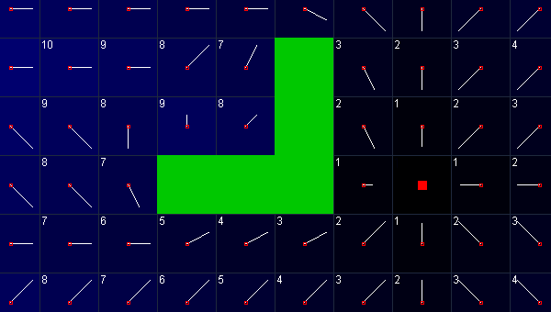
Step 2: Create Flow Field
Stores a vector for every node
Each vector points down to the path to the target
Each vector calculated by looking at the node distances from step 1
Notes:
Now that the path distance from every tile to the goal has been calculated, we can easily determine the path that needs to be taken to get closer to the goal.
It is possible to do this at runtime for every pathfinder every frame, but it is often better to calculate a vector field once and then have all of the pathfinders refer to the vector field at runtime.
The flow field simply stores a vector that points down the gradient of the distance function (towards the goal) at every tile.
You can see that the graphic on this slide is a visualisation of the vector field, with the vectors pointing from the centre of the tile along the shortest path to the goal (shown in red)

Slide 8
Step 2: Create Flow Field
X and Y vector components calculated separately
If the left/right/up/down tile is not traversable, distance of current tile used for the missing value
Normalize vectors to avoid inconsistencies later
Vector.x = left_tile.distance - right_tile.distance
Vector.y = up_tile.distance - down_tile.distance
Notes:
This flow field is generated one tile at a time by looking at the costs for each node that have been previously calculated.
The pseudo code for calculating the x and y components of the vector is shown on this slide. Each component is calculated separately.
If any of the tiles referenced (left/right/up/down) are non-traversable and thus have no usable distance stored, the distance associated with the current tile is used in place of the missing value. Once the path vector has been roughly calculated, it is normalized to avoid inconsistencies later.

Slide 9
Step 3: Agent Movement
Each agent finds which vector in the Flow Field corresponds to the node it is currently on
Very simple if using a 2D grid
The agent simply moves in the direction indicated by the vector
Could be combined with steering behaviours
Notes:
Now that the vector field has been calculated, it is very easy to calculate movement for a pathfinder.
Assuming that vector_field(x,y) returns the vector we calculated earlier at the tile (x,y), and that desired_velocity is a scalar, then to get the velocity for our agent we simply multiply the vector in the flow field by the desired velocity
The agent simply needs to start moving in the direction indicated by the vector.
This is the simplest way of doing this, but more complicated movement systems can easily be implemented.
For example, we could apply steering behaviours to the agent movement. In such a situation the velocity vector we calculated would be used as the desired velocity, and the steering behaviours would be used to calculate the actual movement at every time step.

Slide 10
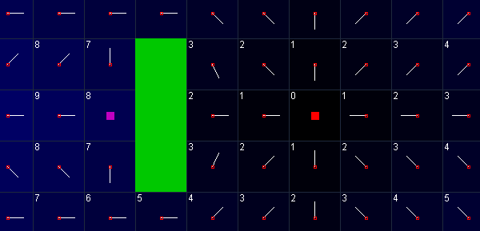
Local Optima
Local optima is a problem that can occur
It happens when the calculated vector components equal 0
Causes pathfinding agents to get stuck
In this image, the pink node shows this problem
Notes:
Now that the vector field has been calculated, it is very easy to calculate movement for a pathfinder.
Assuming that vector_field(x,y) returns the vector we calculated earlier at the tile (x,y), and that desired_velocity is a scalar, then to get the velocity for our agent we simply multiply the vector in the flow field by the desired velocity
The agent simply needs to start moving in the direction indicated by the vector.
This is the simplest way of doing this, but more complicated movement systems can easily be implemented.
For example, we could apply steering behaviours to the agent movement. In such a situation the velocity vector we calculated would be used as the desired velocity, and the steering behaviours would be used to calculate the actual movement at every time step.

Slide 11
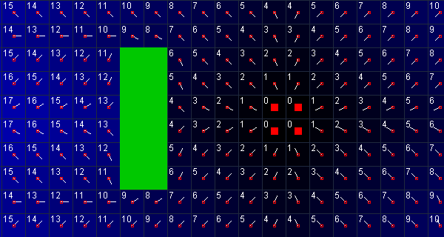
Local Optima
One possible solution uses 4 goal nodes
Split each node into 4 to preserve the original resolution
Goal nodes should be adjacent and traversable
Generating the Flow Field now takes 4x longer
Other solutions involve checking on a case-by-case basis
Notes:
One solution is to subdivide both the node graph and the flow field once. Every single node and flow field tile has now been split into four smaller tiles. The problem remains the same with a subdivided grid; it has only been slightly minimized.
The real trick that solves the local optima problem is to initially add four goal nodes, instead of just one. To do this we simply have to modify the first step of the distance calculation algorithm.
Where we used to have only one goal with a path distance of 0, we now add the four tiles that are closest to the goal.
This technique will still work as long as the four tiles are adjacent and traversable.
The results are shown in the image on this slide.
You can see that by using four goal nodes we have eliminated the local optima problem.
Although this solution is elegant, the calculations required to build the flow field now take four times longer because of the increased number of tiles, so it is far from ideal.
Other solutions involve determining what direction to go in on a case by case basis, which can significantly slow down the agent movement calculations.

Slide 12
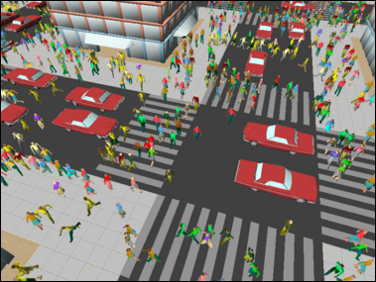
Continuum Crowds
Technique developed by Treuille, Cooper & Popovic, 2006
Integrates global navigation with moving obstacles
Naturally exhibits emergent phenomena observed in real crowds
Notes:
Flow field provide a very workable solution by themselves, which when applied in the right context can not only improve the efficiency of your pathfinding AI, but can also create emergent behaviour giving the appearance that your agents are smarter than they actually are.
A much more advanced approach created for simulating crowds is the continuum crowds algorithm.
This integrates the global navigation of our flow field with moving obstacles to create agent pathfinding behaviour that naturally exhibits emergent phenomena like lane creation and vortices that have been observed in real life.
This technique is quite complex, and contains a fair bit of math. While its implementation is certainly achievable, we will present only a high level overview of this algorithm here.

Slide 13
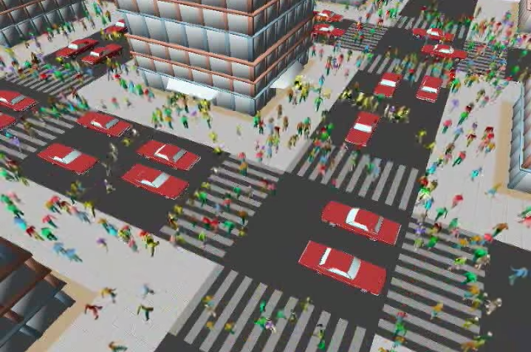
Continuum Crowds
http://grail.cs.washington.edu/projects/crowd-flows/
Notes:
Video – watch it, it’s pretty interesting

Slide 14
Continuum Crowds
More advanced, but involves the same basic concept as our Flow Fields sample
Find the distance from goal for each node
Create a vector for each node
So far everything is the same as with our Flow Fields
Notes:
In the next several slides we’ll take a general look at how this algorithm works. Just remember the details are slightly more complicated than this.
First up, we calculate the distance from the goal for each node, and create a vector for each node, just like we did in our flow fields algorithm.

Slide 15
Continuum Crowds
Create discomfort field (agents will prefer footpaths over roads)
Create height field (agents will prefer going downhill and avoid going uphill where possible)
Create density field (agents will avoid places of high density)
Create velocity field (combines each agent’s current velocity)
Notes:
The next series of steps is all about creating other types of fields which will influence our final ‘possibility field’.
The purpose of these additional fields is to take into account dynamic factors like agent density, as well as terrain topology to create more realistic paths.
We start by creating a discomfort field. We can, for example, apply less discomfort to footpaths and more discomfort to roads, so that agents will prefer walking on the footpath instead of the road.
Next is the height field. This acts a little like the discomfort field: people prefer to go downhill, aren’t affected by no change in slope, and avoid going uphill when possible.
Both of these fields are inputs to Continuum Crowds, and aren't modified by the algorithm.
They can be "dynamic" and changed between timesteps if the caller wants to.
Next we have the density field. This field also acts like the discomfort field, helping people avoid places of high density and prefer places of low density.
The velocity field contains information on each agent’s velocity.

Slide 16
Continuum Crowds
Create speed field (how fast we can travel considering slopes and any movement impediment by agents around us)
This is a key concept: agents are slowed down if moving against the flow
Also causes formation of lanes, vortices, and other emergent phenomena
Notes:
Finally we have the speed field.
Essentially the idea is we have a topological speed, which is how fast we can travel when considering slopes, and a flow speed, which is how much our movement is impeded by those around us.
This is the key idea in Continuum Crowds: units are slowed down if they are moving against the flow, and sped up if they are moving with the flow. It causes the formation of lanes, vortices, and other emergent phenomena that have been observed in real crowds.

Slide 17
Continuum Crowds
Use the fields to calculate the potential field
Use the potential field to calculate final velocities at each node
Move agents according to these velocities
Much of this implementation could be done on the GPU
Notes:
The potential field combines the other fields to create the vectors that tell us what direction we’re going to move.
The formulas, while not overly complex, are too involved to go into here, however the references section has some links should you require more information.
Once we have calculated the potential field, we normalize it and multiply it by the value in the speed field at the same location to get the final velocity for the agent.
All that remains is to move the agent according to these calculated velocities.
While there are quite a few more steps involved with this algorithm, its important to note that much of this could be performed on the GPU.

Slide 18
Where is this used?
The Continuum Crowds algorithm was demonstrated in ATI’s technical demonstration of the Radeon HD 4800 series (2008)
Generated much interest for games
Now a staple of RTS games
Implemented in Supreme Commander 2 (2010)

Slide 19
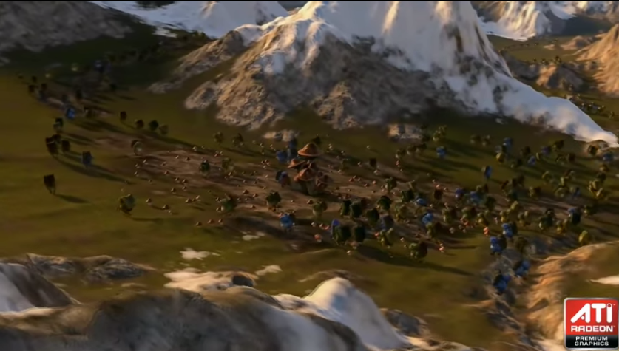
March of the Froblins
https://www.youtube.com/watch?v=FUtzOqgsLyE
Notes:
Video – very interesting, only need to show the first couple minutes or so.
There are other online videos that go into the specific implementation. The reference section contains a link to the original ATI papers and Siggraph presentations

Slide 20
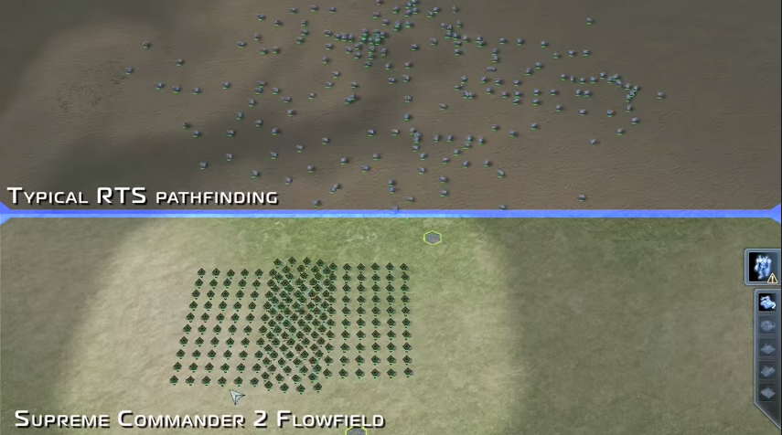
Supreme Commander 2
https://www.youtube.com/watch?v=bovlsENv1g4
Notes:
Video – this is a very good video because it compares a flow field implementation with a typical RTS pathfinding implementation
You can show all of this video.

Slide 21
Summary
Flow Fields allow us to calculate the path to goal once, and use the data to update all agents
Calculate a distance from the goal for each node
Generate the Vector Field
Update the position of each agent
Continuum Crowds is an extension of this basic concept for real-time simulation of crowds

Slide 22
References
Sidney Durant. 2013. Understanding Goal-Based Vector Field Pathfinding. [ONLINE] Available at:http://gamedevelopment.tutsplus.com/tutorials/goal-based-vector-field-pathfinding--gamedev-9007. [Accessed 26 March 15].
Dani Phye . 2014. Implementing Continuum Crowds. [ONLINE] Available at:http://computationalbubblegum.blogspot.com.au/2014/06/implementing-continuum-crowds-part-1.html. [Accessed 26 March 15].
Treuille, A. Cooper, S. Popović, Z., 2006. Continuum Crowds. ACM Transactions on Graphics 25 (3).
GRAIL UW CSE Graphics and Image Laboratory. 2006. Crowd Flows. [ONLINE] Available at:http://grail.cs.washington.edu/projects/crowd-flows/. [Accessed 26 March 15].
AMD Developer Central. 2014. Radeon™ HD 4800 Series Real-Time Demos. [ONLINE] Available at:http://developer.amd.com/resources/documentation-articles/gpu-demos/ati-radeon-hd-4800-series-real-time-demos/. [Accessed 26 March 15].
Notes:
march of the froblins: https://www.youtube.com/watch?v=FUtzOqgsLyE
Chris Taylor's Kings and Castles: https://www.youtube.com/watch?v=L2KezvQLllw
Chris Taylor's Supreme Commander 2: https://www.youtube.com/watch?v=bovlsENv1g4
(good example)
continuum crowds JS implementation:
https://howtorts.github.io/2014/01/09/continuum-crowds.html
https://howtorts.github.io/examples/8-1-crossing-groups-continuum-crowds/
Computational Bubblegum
Implementing Continuum Crowds, Part 1: Writing an Eikonal Equation Solver
http://computationalbubblegum.blogspot.com.au/2014/06/implementing-continuum-crowds-part-1.html
http://computationalbubblegum.blogspot.com.au/2014/06/implementing-continuum-crowds-part-2.html
flow field howto: http://coldconstructs.com/2013/10/flow-field-pathfinding-with-flocking/
Understanding Goal-Based Vector Field Pathfinding *** simple & good
https://www.youtube.com/watch?v=Bspb9g9nTto
http://gamedevelopment.tutsplus.com/tutorials/goal-based-vector-field-pathfinding--gamedev-9007
How to RTS:
https://howtorts.github.io/2014/01/09/continuum-crowds.html
Flow field pathfinding with flocking
http://coldconstructs.com/2013/10/flow-field-pathfinding-with-flocking/

